Slide 1

Hardware Accelerated Networking for Data Center and Distributed Machine Learning
Microsoft Research
Yongqiang Xiong
Joint work with Ran SHU, Peng CHENG, Guo CHEN, Zhiyuan GUO, Lei Qu, Derek Chiou, Thomas Mochibroda
²⁰¹⁹⁻⁰⁸⁻¹⁷
Microsoft Research Asia

Slide 2
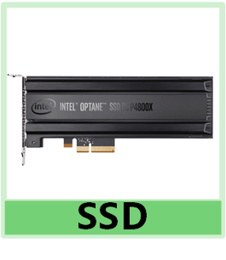
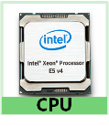
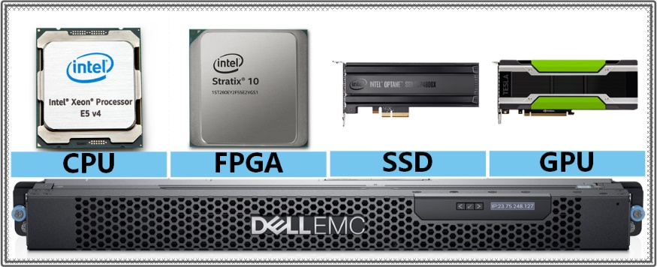
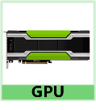
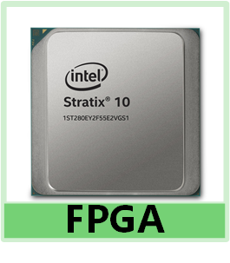
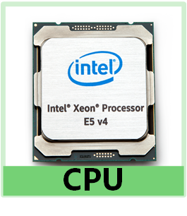

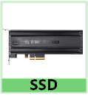
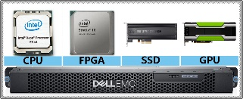


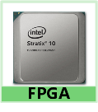
Background: Server-centric Computing
Resources bound/shared/clustered: relying on server CPU/memory
Can we make resources independent from servers?
Notes:
With the computing paradigm shifting to data centers, we see more and more computing and storage devices emerging, such as CPU, FPGA, SSD, GPU, but currently resources are bound with servers, shared and clustered with the dependency of server CPU and memory. This introduces non-trivial cost to servers, especially for many machine learning tasks, for example, GPU need to load training data from NVMe SSD, and exchange gradients with other GPUs, but nowadays, most of them need to pass through server CPU or memory, and its quite costly, So our question is, can we make the resources independent from servers?

Slide 3
Vision: Break Server Boundary in Cloud
Everything visible and directly accessible on unified Flat network
Global resource naming, routing, and communication.
Harmonize data center networking (Ethernet) and host-area networking (PCIe)
Everything managed and divided dynamically by Cloud
No boundaries & dependency from individual servers
Unified Network
Data Center Networking Fabrics (RDMA/Ethernet)
Server1
Server2
ServerN
Host Switching (unified Ethernet + PCIe)
Host Switching (unified Ethernet + PCIe)
Host Switching (unified Ethernet + PCIe)
CPU
GPU
FPGA
APU
CPU
GPU
FPGA
APU
CPU
GPU
FPGA
APU
NVMe
ACC Card
NIC
NVMe
ACC Card
NIC
NVMe
ACC Card
NIC
Notes:
Our vision is to break server boundary in the cloud, so every resource is addressable and directly accessible on the unified flat network, this needs global …
And every resource should be managed and divided/assembled dyna

Slide 4
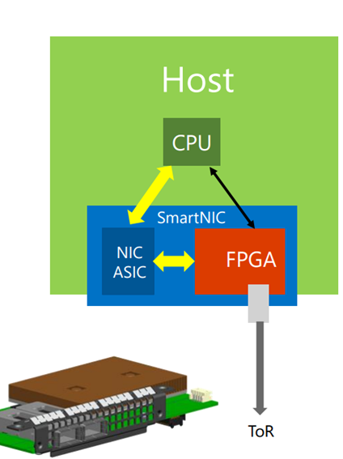
One Step Further Beyond Microsoft SmartNIC
Notes:
We all know about the Microsoft SmartNIC, that’s a bump-in-wire solution mainly targeting at networking virtualization with generic flow table offloading. Our proposal is a step further

Slide 5
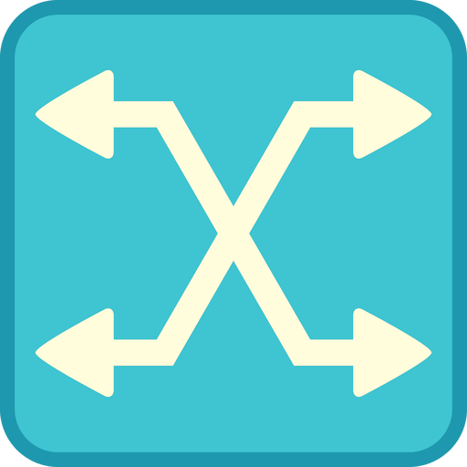
Proposal: Terminus as the “Server Center”
All Resources partitioned, virtualized and connected by Terminus hardware
CPU, DRAM, storage, NIC, GPU, FPGAs, AI ASICs
Future-device proof with programmable adaptors
Challenges
Unified interconnection layer
Leveraging existing infrastructure
Global and heterogeneous dev-to-dev collaborations
Direct universal access to interconnect cloud resources
Super high efficiency
High switch capacity/bandwidth
CPU-bypass and host-memory-bypass
Provide fine-grained hardware QoS
SSD
SSD
SSD
SOS: SiliconOS
Memory
CPU
Terminus NIC
SOS SOS
SOS
SOS
SoC
SOS
GPU
Switch
Memory
CPU
GPU
SOS
SOS
FPGA
SOS SOS
SOS
SOS
M.2
M.2
M.2
FPGA/
Brainslice
Notes:
FPGAs started to replaced CPUs in MS Cloud servers for some tasks in 2015

Slide 6
Traditional 5-layer, again…
FINISH
ONGOING
IN PLAN
Virtualization
Storage
Machine Learning
Application
VM
Docker
RocksDB
AIPre
H.W. Scheduler
H.W.
PS
SiliconInterface
MPI
Unified Interface
Generic LANE(G-LANE)
GPU Interface
FPGA Interface
SiliconTransport
Credit-based Host Internal Protocol
MP-RDMA
Stateless Transport /
QCQCN + PFC
Reliable Transport
NSDI 18
SiliconNet
Direct Universal Access (DUA) for SiliconOS through network
Universal Switch
NSDI 19
SiliconStack
G-LANE
Stack
GPU
Stack
FPGA
Connect
NVMe Stack
DMA
Engine
NIC
Stack
Network Stack
Underlay Stack
SiliconOS
Hardware/Network/Application Logic Interface, local memory, dev mgmt., libraries
Unified FPGA OS
Hardware resource
CPU
GPU
FPGA
NVMe
Memory
NIC
On-chip
NIC
Computation Node
Passive Device
Communication Component

Slide 7
Today’s Focus
FINISH
ONGOING
IN PLAN
Virtualization
Storage
Machine Learning
Application
VM
Docker
RocksDB
AIPre
H.W. Scheduler
H.W.
PS
SiliconInterface
MPI
Unified Interface
Generic LANE(G-LANE)
GPU Interface
FPGA Interface
SiliconTransport
Credit-based Host Internal Protocol
MP-RDMA
Stateless Transport /
QCQCN + PFC
Reliable Transport
NSDI 18
SiliconNet
Direct Universal Access (DUA) for SiliconOS through network
Universal Switch
NSDI 19
SiliconStack
G-LANE
Stack
GPU
Stack
FPGA
Connect
NVMe Stack
DMA
Engine
NIC
Stack
Network Stack
Underlay Stack
Work with Bing
SiliconOS
Hardware/Network/Application Logic Interface, local memory, dev mgmt., libraries
Unified FPGA OS
Hardware resource
CPU
GPU
FPGA
NVMe
Memory
NIC
On-chip
NIC
Computation Node
Passive Device
Communication Component

Slide 8
Direct Universal Access
Server
Server
FPGA 1
FPGA 2
FPGA 3
App 1
App 2
①
④
DUA
DUA
DUA
DDR access
LTL
FPGA Connect
Host
DMA
DDR access
FPGA Connect
Host DMA
DDR access
LTL
FPGA Connect
Host
DMA
②
CPU
DDR
QSFP
PCIe Gen3
DDR
PCIe Gen3
DDR
QSFP
PCIe Gen3
Intra-server networking fabric
③
Datacenter networking fabric
Notes:
To address these problems, we propose DUA.
I first use an example to show how DUA works.
In this example, application 1 want to send a message to application 2 running on a remote server’s FPGA.
It first send the message to DUA on FPGA 2.
DUA system finds that this FPGA board does not have an Ethernet port.
It forwards this message to FPGA 1 in the same server which has Ethernet port.
Then the DUA forward this message to FPGA 3 through Ethernet.
Finally the message reaches application 2.

Slide 9
DUA Overview
DUA is an “IP layer”
An abstract overlay network
Leverage all existing h/w stacks
Hierarchical addressing & routing
Server
Server
FPGA
FPGA
App
App
App
App
App
App
①
④
DUA
DUA
DUA
DDR access
LTL
FPGA Connect
Host
DMA
DDR access
FPGA Connect
Host DMA
DDR access
LTL
FPGA Connect
Host
DMA
②
CPU
DDR
QSFP
PCIe Gen3
DDR
PCIe Gen3
DDR
QSFP
PCIe Gen3
Intra-server networking fabric
③
Datacenter networking fabric
Notes:
From the previous example, we can see that DUA is an IP layer for FPGAs to access all resources in data center.
DUA connects stacks and applications as a router and builds an abstract overlay network to unify all access.
DUA leverages existing communication stacks and can adopt future ones.
DUA doesn’t break the data center network but leverages existing address and routing design. This makes DUA simple and easy to deploy.

Slide 10
DUA Overview
DUA is an “IP layer”
Server
Server
FPGA
FPGA
Efficient Routing
Direct resource access by FPGA, totally bypass CPU
App
App
App
App
App
App
①
④
DUA
DUA
DUA
DDR access
LTL
FPGA Connect
Host
DMA
DDR access
FPGA Connect
Host DMA
DDR access
LTL
FPGA Connect
Host
DMA
②
CPU
DDR
QSFP
PCIe Gen3
DDR
PCIe Gen3
DDR
QSFP
PCIe Gen3
Intra-server networking fabric
③
Datacenter networking fabric
Notes:
DUA enables every application to access any resource in datacenter directly, no proxy application is needed.
Besides that, all the routing totally bypass CPU which provides extremely low latency.

Slide 11
DUA Overview
DUA is an “IP layer”
Server
Server
FPGA
FPGA
Efficient Routing
App
App
App
App
App
App
Compatible BSD-socket Interface
for both applications and communication stacks
①
④
DUA
DUA
DUA
DDR access
LTL
FPGA Connect
Host
DMA
DDR access
FPGA Connect
Host DMA
DDR access
LTL
FPGA Connect
Host
DMA
②
CPU
DDR
QSFP
PCIe Gen3
DDR
PCIe Gen3
DDR
QSFP
PCIe Gen3
Intra-server networking fabric
③
Datacenter networking fabric
Notes:
DUA provides a unified BSD-socket-like interface for all FPGA applications to access heterogeneous endpoint in datacenter which significantly reduce the programming effort.
Communication stacks development can also benefit from the unified interface.

Slide 12
DUA Overview
DUA is an “IP layer”
Server
Server
FPGA
FPGA
Efficient Routing
App
App
App
App
App
App
Compatible BSD-socket Interface
①
④
DUA
DUA
DUA
General Multiplexing
for both applications and communication stacks
DDR access
LTL
FPGA Connect
Host
DMA
DDR access
FPGA Connect
Host DMA
DDR access
LTL
FPGA Connect
Host
DMA
②
CPU
DDR
QSFP
PCIe Gen3
DDR
PCIe Gen3
DDR
QSFP
PCIe Gen3
Intra-server networking fabric
③
Datacenter networking fabric
Notes:
DUA provides general multiplexing for applications and communication stacks.
Programmers need to care about implementing multiplexer anymore.

Slide 13
DUA Overview
DUA is an “IP layer”
Server
Server
FPGA
FPGA
Efficient Routing
App
App
App
App
App
App
Compatible BSD-socket Interface
①
④
DUA
DUA
DUA
Compatible BSD-socket interface
Unified Multiplexing
Security
Protect against both inside and outside attacks
DDR access
LTL
FPGA Connect
Host
DMA
DDR access
FPGA Connect
Host DMA
DDR access
LTL
FPGA Connect
Host
DMA
②
CPU
DDR
QSFP
PCIe Gen3
DDR
PCIe Gen3
DDR
QSFP
PCIe Gen3
Intra-server networking fabric
③
Datacenter networking fabric
Notes:
DUA not only protects FPGA applications and stacks from outside malicious traffic, it can also protect the hosting server and even data center network from anomalous FPGA applications and stacks.

Slide 14
System Architecture
Server
FPGA
DUA Data Plane
DUA
data plane
DUA
Overlay
DDR Controller
App
Host DMA
FPGA Host Stack
App
CPU
NVMe Stack
App
FPGA Connect
CPU Control Agent
LTL
Server
FPGA Control Agent
DUA Underlay
FPGA
CPU
FPGA
DDR
QSFP
PCIe Gen3
Intra-server networking fabric
NIC
NIC
Datacenter networking fabric
Notes:
This block diagram shows the DUA system architecture.
Since FPGAs are not suitable for implementing the complicated control logic. Data plane and control plane are separated in DUA.
DUA data plane lies in all FPGAs as a router.
It provides efficient routing, unified interface, general multiplexing and security.

Slide 15
System Architecture
Server
FPGA
DUA Data Plane
DUA
control plane
DUA
Overlay
DDR Controller
App
Host DMA
FPGA Host Stack
App
CPU
NVMe Stack
App
FPGA Connect
CPU Control Agent
LTL
Server
FPGA Control Agent
DUA Underlay
FPGA
CPU
FPGA
DDR
QSFP
PCIe Gen3
Intra-server networking fabric
NIC
NIC
Datacenter networking fabric
Notes:
DUA puts the main control logic in the CPU.
FPGA control agents only monitor and update the local status.
Each server has a CPU control agent to determine all control logic within this server.

Slide 16
DUA Control Plane
Challenge: large-scale resource and routing info dissemination
Limited h/w resource
DUA solution
Hierarchical addressing
Hierarchical routing
Leverage existing infrastructure
Fully distributed and lightweight
Need no global synchronization
Resource table
Interconnection table
Notes:
While for the data center wide, DUA control plane is organized in a distributed way.
Each CPU only maintain its local resource and routing information.
In order to realize this idea. DUA use a hierarchical address format. It leverages the server IP address as first level and let each CPU control agent manages its local address as second level.
For routing calculation, the idea is similar. Each server only manages its local routing. For cross server communications, both side’s CPU control agent calculate the intra-server routing path and leverage data center routing to build the end-to-end route. By this design, DUA avoid global synchronization.

Slide 17
DUA Data Plane
FPGA
DUA data plane
Overlay
Unified interface
Routing
Stacks
Leverage all the existing (or adopt future) stacks
Underlay
Efficient multiplexing
Security
DUA
overlay
DDR Access
App
Host DMA
App
FPGA Host stack
App
NVMe Stack
FPGA Connect
LTL
DUA underlay
DDR
QSFP
PCIe Gen3
Notes:
Data plane consists of three parts. The overlay connects all application and stacks with unified interface and provide routing among all connected end points. This design also solves the stack multiplexing problem.
DUA leverages all existing or adopt future stacks.
The underlay solves the physical interface multiplexing and provide security check.

Slide 18
DUA Data Plane – Overlay
Efficient & extensible design
Switch fabric
High capacity cross-bar switch
Connector
All cached routing tables
Translator
Protocol translation
High performance data path
Line-rate
Near zero-delay
App
App
App
DUA
overlay
Connector
Connector
Connector
FPGA CA
Switch Fabric
Connector
Connector
Connector
Connector
LTL Translator
DDR Translator
Host DMA Translator
FPGA Connect
LTL
DDR
Host DMA
Notes:
Let’s go deeper into the overlay.
In the center is a crossbar switch that switches messages between stacks and applications.
All routing tables are cached in data plane to ensure all data transmission totally bypass CPU.
To avoid the contention during table lookup. Each connector keeps its own routing table.
Only the active connections related to a connector is cached in the table, thus the table size can be very small.
Since existing communication stacks all have their own interface. DUA adds stack translators to convert between interfaces.
Translators are carefully implemented to provide line-rate and near zero-delay.

Slide 19
Evaluation – efficiency
FPGA 1
FPGA 2
FPGA 3
FPGA 4
APP
DUA overlay
DUA overlay
APP
FPGA Connect
FPGA Connect
LTL
LTL
FPGA Connect
FPGA Connect
Extreme low latency (< 50 ns/fwd)
Round Trip Time through FPGA Connect and DUA for 4 times, LTL twice
Notes:
Here we use an experiment to show DUA efficiency.
We connect two FPGAs located in different servers. Both FPGAs do not have Ethernet port. DUA route traffic through other FPGAs with Ethernet for this communication.
The entire round-trip passes PCIe for 4 times, Ethernet for twice and DUA for 4 times.
The round-trip time breakdown is shown in the bottom figure.
DUA only introduces less than 200 ns latency which is less than 5% of total latency.
And for each forwarding, DUA only cause less than 50 ns.

Slide 20
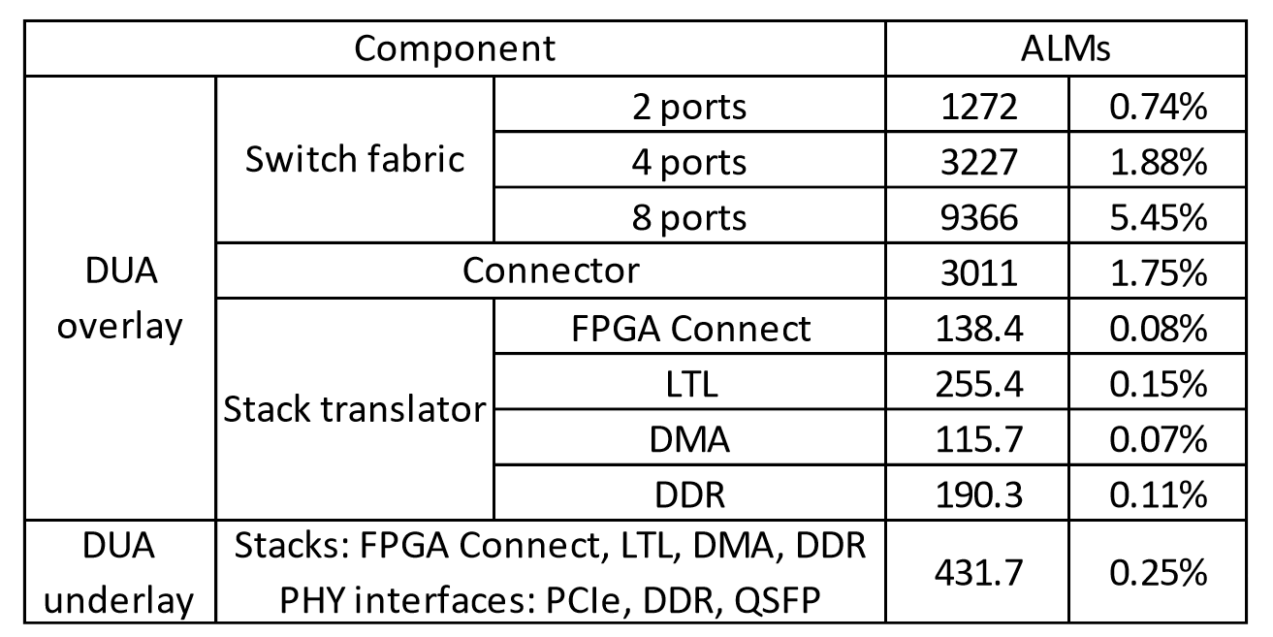
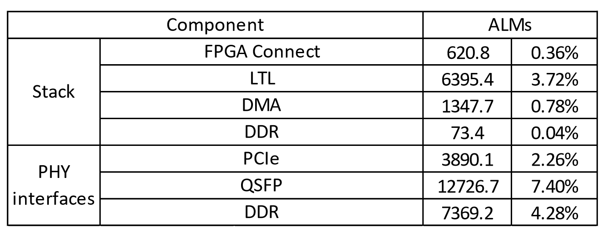
Evaluation – Logic Overhead
DUA Overlay
2 Ports: 4.24%
4 Ports: 9.29%
8 Ports: 19.86%
DUA Underlay
4 Stacks and 3 PHY Interfaces: 0.25%
Notes:
Providing such low latency, DUA only introduces low FPGA logic overhead in our middle-end FPGA.
A typical 4 ports DUA implementation only consumes about 10 percent of FPGA logic resources.
These numbers will be significantly reduced by 2-3 times on the next generation FPGA.

Slide 21
Application: Terminus for AI

Slide 22
Application: Terminus for AI Acceleration
AI Training
AI Preprocessing
AI Training
AI Preprocessing
Transform
Data Load
Decode
Glane Library
User
Data Load
Kernel
User
Windows Driver
Decode
Transform
AI-Pre
Kernel
Terminus
NVMe SSD
NVMe SSD
Existing
Terminus

Slide 23
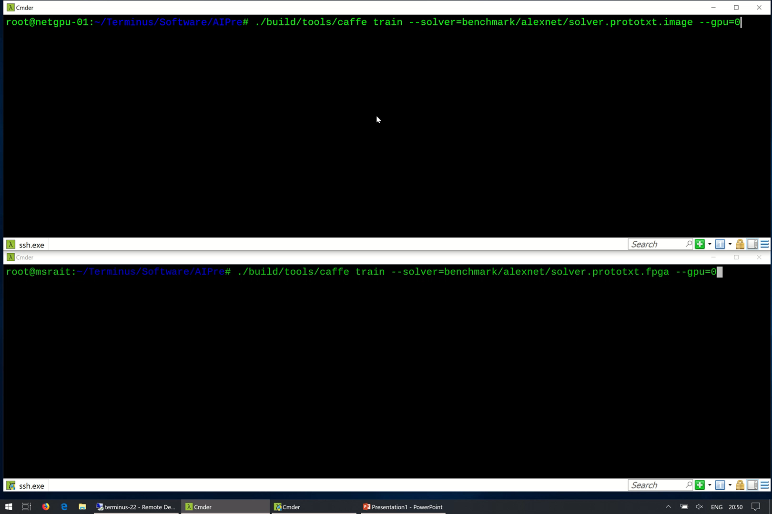

Slide 24
Application: Terminus for AI Acceleration
Platform: NVCaffe, Neural Network: AlexNet, Batch Size: 256 images, I/O Thread: 12 threads / GPU
1*P100
2*P100
Save >7 Cores per GPU
Remove Software I/O Bottleneck

Slide 25
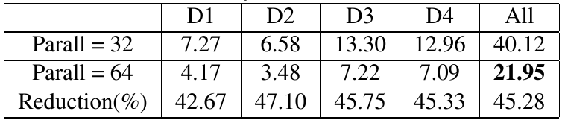
AI Application #2 – Deep Crossing
Single FPGA Board: Parall = 32, 2 FPGA Board: Parall = 64
45.28% Latency Reduction
Notes:
Deep crossing is a deep neural network proposed for handling web-scale application and data sizes.
The model trained from the learning process is deployed in Bing.
The critical metric is latency since it impacts service response time.
By using DUA, we easily extend the application from single board to multiple boards and doubled the parallel degree.
It only incurs 26 extra lines of OpenCL code to call the DUA interface to connect the two FPGA boards.
It result in 45 percent latency reduction which greatly improve user experience.

Slide 26
Conclusion
Terminus: Hardware Accelerated Networking in Data Center
Break the server boundary
Benefits to both public and private cloud
Direct Universal Access
Build the “IP” layer for hardware networking in data center
In process of open source…
Hardware Accelerated Networking for Distributed Machine Learning
AI acceleration for disk/network I/O, instead of offloading the ML algorithms
Notes:
To conclude this talk.
Current FPGA communication architecture does not provide universal access to resources.
We propose DUA as the “IP” layer of FPGA communication which provide efficient routing, unified interface, general multiplexing and security.
We will open source soon.

Slide 27
backup

Slide 28
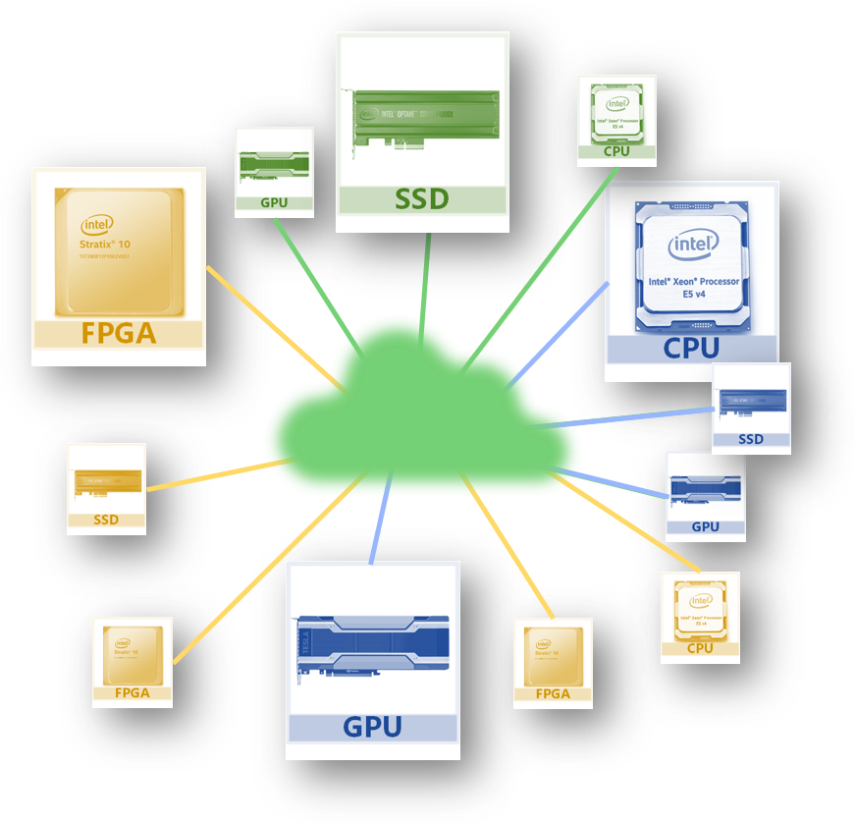
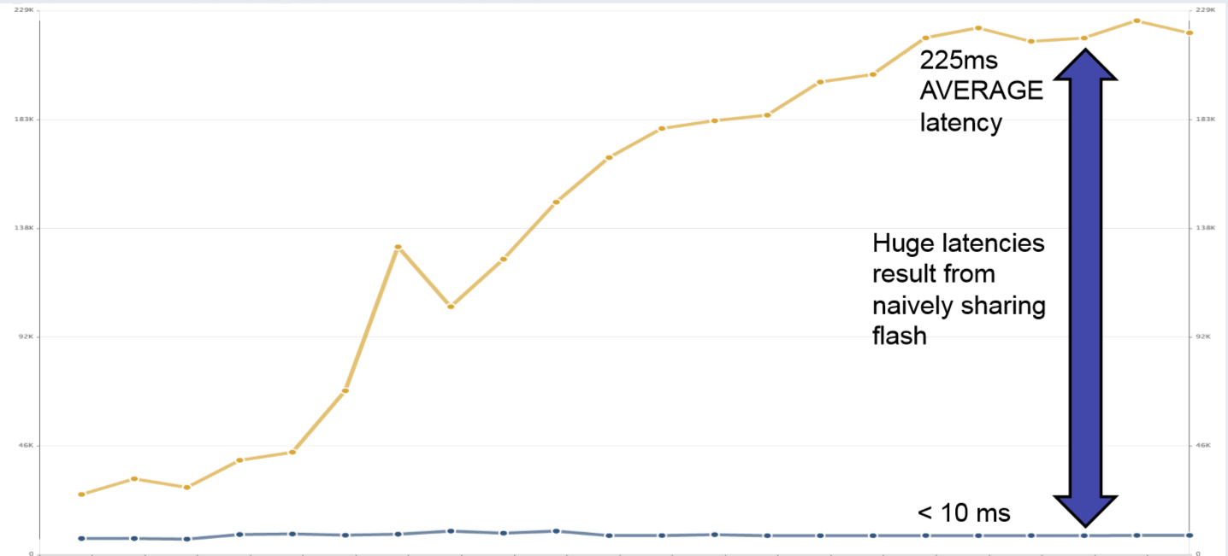
Benefit
Public Cloud Efficiency
High resource utilization
VM dynamically assembled from data center resources
Azure Billable Utilization < 70%; Actual Utilization < 10%
Global direct access without CPU involvement
Harmonize data center (Ethernet) and host-area (PCIe) network
Private Cloud Characteristics
Bare metal performance and predictability
Avoid Noisy Neighbors for Disk Access, I/O Unfairness, etc.
Security: minimize side channel attacks
Noisy Neighbors for Disk Access: 10ms → 225ms^{[1]}

Slide 29
Application – Regex Matching
Up to 10⁵~10⁷ higher than CPU, Up to 10⁵ lower than CPU
Up to 3 times throughput and up to 55% latency reduction compared to using CPU to move data between FPGAs
Notes:
Regular expression matching is widely used in application gateway and IDS inside data center. We use FPGA to accelerate the matching computation by several magnitudes.
However current acceleration need to use CPU to move data between FPGAs. With DUA support, data can be sent directly through FPGAs. We further reduce the latency by half and improve the throughput up to 3 times.

